Slide 1
Cultural Warfare
Deuteronomy 7:1-3
Rodney Hall

Slide 2
RestoreThePaths.com
Facebook.com/RestoreThePaths
Twitter: @RestoreThePaths
Devotionals
Downloads
This Slide Presentation
Enemies of the Promise
More
Brand NEW!

Slide 3
The Real Danger
Cultural Warfare
We will be looking at Deuteronomy 7:1-3

Slide 4
Deuteronomy 7:1 - 3 (MSG)
¹When God, your God, brings you into the country that you are about to enter and take over, he will clear out the superpowers that were there before you: the Hittite, the Girgashite, the Amorite, the Canaanite, the Perizzite, the Hivite, and the Jebusite. Those seven nations are all bigger and stronger than you are. ²God, your God, will turn them over to you and you will conquer them. You must completely destroy them, offering them up as a holy destruction to God. Don’t make a treaty with them. Don’t let them off in any way.

Slide 5
God Says (Deuteronomy 7)
Don’t Partner
Purge Religious Artifacts
You are “Set-Apart”
God Rewards
Obedience → Prosperity

Slide 6
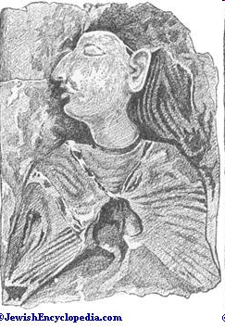
Hittites
“Sons of Terror”
“Storm God”
Also gods of conquered nations (Polytheistic)
Weapons: Fear & Terror
Goal: Depression & Discouragement
Loved War
Notes:
Storm god – Power / Destruction
Without Covenant – Uncircumcised

Slide 7
Hittites
“God did not give us a spirit of cowardice, but rather a spirit of power and of love and of self-discipline.” _{(2 Tim1:6-7 NRSV)}
“There is salvation in no one else, for there is no other name under heaven given among mortals by which we must be saved.” _{Acts 4:12 (NRSV)}

Slide 8
Girgashites
“Clay Soil Dwellers”
Fleshly / Earthly Focus
Lacked Spiritual Sight (Faith)
Corrupt / Immoral
Pride of Life
Little Compromises
Hated God’s people
Notes:
Pride of life: Proud of earthly/temporal accomplishments

Slide 9
Girgashites
“Do not love the world or the things in the world. The love of the Father is not in those who love the world; for all that is in the world—the desire of the flesh, the desire of the eyes, the pride in riches—comes not from the Father but from the world. And the world and its desire are passing away, but those who do the will of God live forever.”
^{1 John 2:15 - 17 (NRSV)}

Slide 10
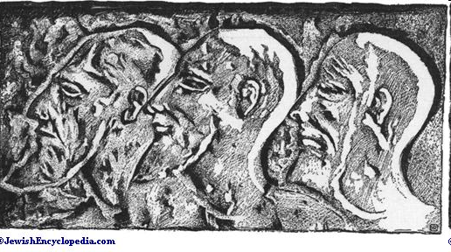
Amorites
“Mountain Dwellers” – “Renowned”
Moon God “sin” / Astrology
Obsessed with fame, glory and power
Giant
Control
Witchcraft & Impure Mysteries (secret)
Notes:
Also Pluralistic / Pantheistic

Slide 11
Amorites
“Those who lived high and mighty he knocked off their high horse. He used the city built on the hill as fill for the marshes.” Isaiah 26:5 (MSG)
“Take no part in the unfruitful works of darkness, but instead expose them.”
Ephesians 5:11 (NRSV)

Slide 12
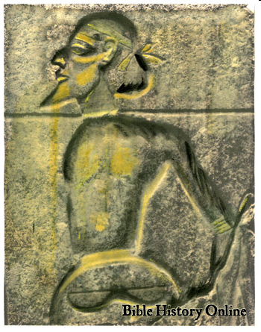
Canaanites
“Lowlands People”
Pantheistic Worship / Idols
Sought approval of others
Deviant Sex
Violence
Child Sacrifice
Notes:
Sympathetic Magic – Influence the gods’ actions by performing the behavior they wished the gods to demonstrate.
Baal / Asherah – Mother/Mistress (believed immoral sex would cause the gods to “get together” which would ensure good harvest
- Basis of religious prostitution
http://followtherabbi.com/guide/detail/fertility-cults-of-canaan
Incest as a form of worship “whole family” and temple prostitutes Every imaginable kind.
* http://mccphiladelphia.com/leviticus.htm (supportive of committed homosexual relationships)
*http://www.theology.edu/canaan.htm

Slide 13
Cannanites
“Surely you know that the people who do wrong will not inherit God’s kingdom. Do not be fooled. Those who sin sexually, worship idols, take part in adultery, those who are male prostitutes, or men who have sexual relations with other men, those who steal, are greedy, get drunk, lie about others, or rob—these people will not inherit God’s kingdom. ”
^{1 Corinthians 6:9 (NCV)}

Slide 14
Perizzites
“Village Dwellers”
Towns Without Walls
No Boundaries
Lazy
Short-sighted

Slide 15
Perizzites
“A person without self-control is like a city with broken-down walls.”Pr 25:28 (NLT)
“Where there is no prophecy, the people cast off restraint, but happy are those who keep the law. Pr 29:18 (NRSV)

Slide 16
Hivites
“Living in the Village”
Unable to resist (unwalled)
Short sighted
Instant / Immediate Gratification / Pleasure
Deceit / Lies

Slide 17
Hivites
You should know this, Timothy, that in the last days there will be very difficult times. For people will love only themselves and their money… and love pleasure rather than God. They will act religious, but they will reject the power that could make them godly. Stay away from people like that! Pr 25:28 (NLT)

Slide 18
Hivites
“I consider that the sufferings of this present time are not worth comparing with the glory about to be revealed to us.”
^{Romans 8:18 (NRSV)}

Slide 19
Jebusites
“Threshers” – “Kings / Lords”
Legalistic
Spiritual Control / Abuse
War Like / Threatening
Held Jerusalem (Jebu)
Yasser Arafat and other PLO leaders have claimed to be descendents of the Jebusites

Slide 20
Jebusites
“Do not lord it over those in your charge, but be examples to the flock.”
^{1 Peter 5:3 (NRSV)}

Slide 21
There is an us and a them

Slide 22
“I am not afraid that the people called Pentecostals should ever cease to exist... But I am afraid that they will survive only as an empty shell of what they once were, having a form of religion but without power. This is inevitable - unless - they hang on desperately to the Word of God with passion, and discipline which they demonstrated in the beginning.” - paraphrase of John Wesley for us

Slide 23
"Teach me your ways, O LORD, that I may live according to your truth! Grant me purity of heart, so that I may honor you." Ps 86:11 (NLT)

Slide 24
RestoreThePaths.com
Facebook.com/RestoreThePaths
Twitter: @RestoreThePaths
Rodney@RestoreThePaths.com

